Slide 1
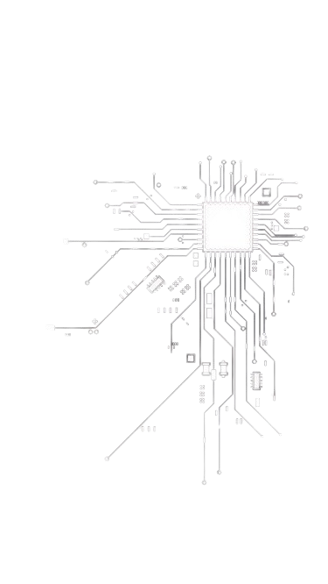
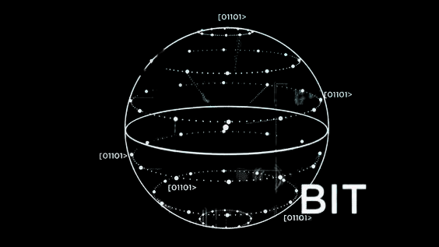




QUANTUM
QUANTUM
DIRECT
DIRECT
COMMUNICATION
COMMUNICATION
Rwaida Alajlan, Lama Alqied, Deem Alsuhaibani
Sensitive Data Transfer

Slide 2





TABLE OF CONTENTS
TABLE OF CONTENTS
OVERVIEW
PROTOTYPE
PROBLEM STATEMENT
QUANTUM CIRCUIT
OBJECTIVE
CONCLUSION
IMPLEMENTATION
GITHUB

Slide 3


OVERVIEW
In today's world, the need to transfer sensitive data across various sectors is ever-present. However, traditional encryption methods using keys , while effective to a certain extent, are susceptible to attackers trying to decrypt the file without key or quantum computing advancements that could potentially compromise their security.
To address these vulnerabilities, we have developed a two-step Quantum Direct Communication Protocol. This protocol introduces an additional layer of security by enabling direct communication between two parties, thus mitigating the risks associated with traditional encryption methods.

Slide 4



PROBLEM
PROBLEM
STATEMENT
STATEMENT

Slide 5
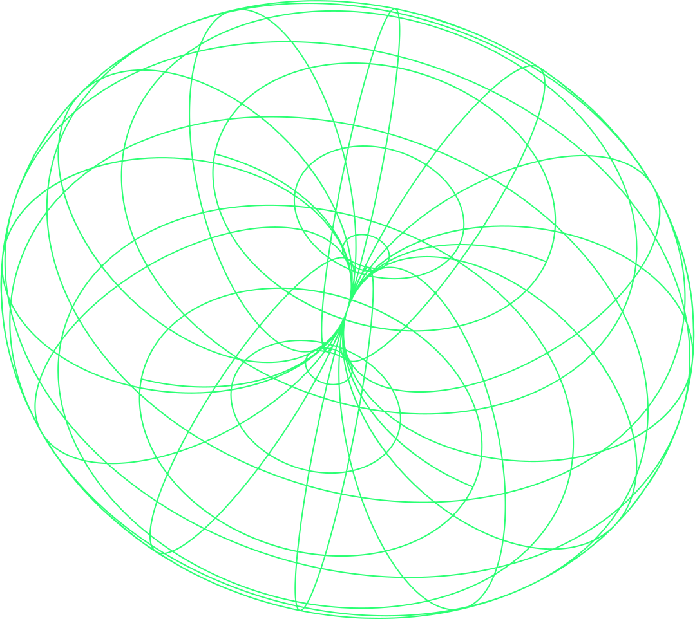







OBJECTIVE
OBJECTIVE
Secure File Transfer
Direct Communication
Efficiency
ensure the confidentiality and integrity of the file during transmission
allows for direct communication between two parties without the need for public or private key
minimize the time and resources required for file transfer while maintaining a high level of security

Slide 6

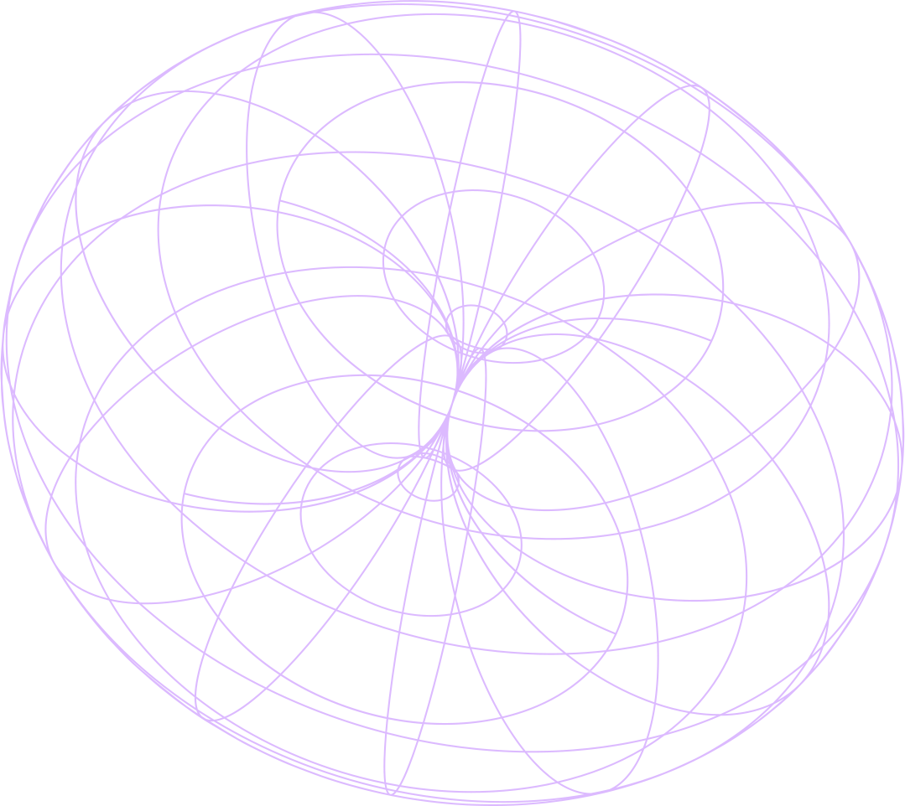
IMPLEMENTATION
QISKIT
is an open-source software development kit (SDK) for working with quantum computers at the level of circuits, pulses, and algorithms.
PYTHON
is a high-level, general-purpose programming language. Its design philosophy emphasizes code readability with the use of significant indentation.

Slide 7


PROTOTYPE
NORMAL-FLOW
Sender
Receiver
Encoding

Slide 8
PROTOTYPE
NORMAL-FLOW
Sender
Receiver
Decoding

Slide 9


PROTOTYPE
SUB-FLOW
Attacker
Sender
Receiver

Slide 10
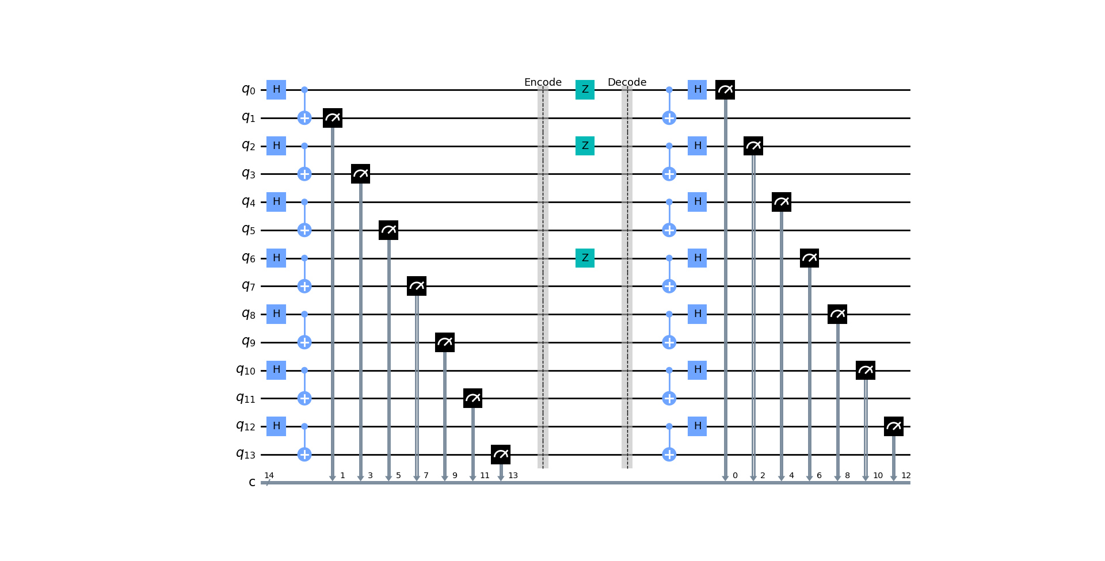
QUANUM CIRCUIT

Slide 11
CONCLUSION
CONCLUSION

Slide 12


GITHUB!
GITHUB!

Slide 13
THANK YOU!
THANK YOU!

